Slide 1
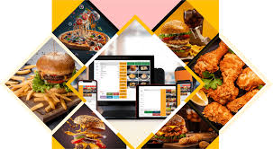
Restaurant Database Management
System
Group 15
Project By:
Moulesh Manikandan
M. Abed
Navtej Randhawa
Jinal Mehta
Supria Deka

Slide 2
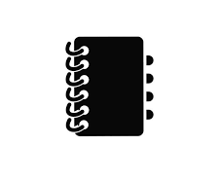
AGENDA
PROJECT OVERVIEW
DATA SOURCE
ERD PLANNING
RELATIONAL SCHEMA MAPPING
QUERY EXECUTION
CONCLUSION

Slide 3
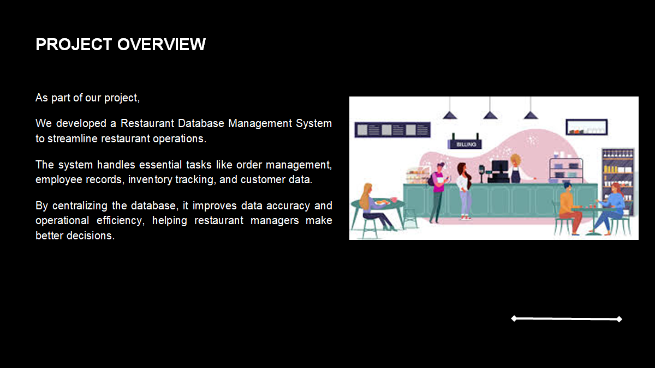


PROJECT OVERVIEW
As part of our project, we developed a comprehensive Restaurant Database Management System designed to streamline the management of restaurant operations. This system serves as the backbone for storing, organizing, and retrieving essential data, ensuring efficient and effective decision-making.
This focuses on maintaining key functionalities such as order management, menu details, staff records, inventory tracking, and customer information. By creating and managing a centralized database, the system aims to eliminate redundancies, improve data accuracy, and enhance operational efficiency.

Slide 4
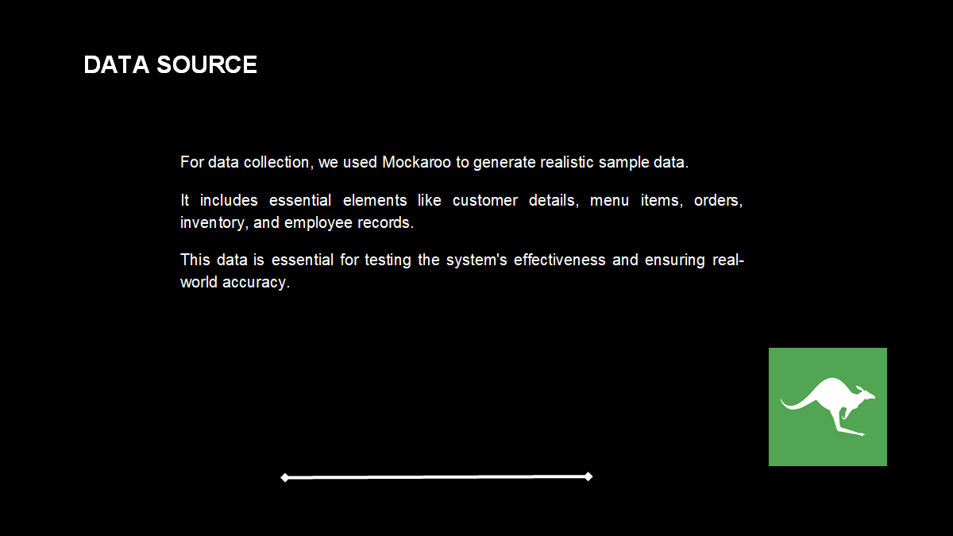

DATA SOURCE
For this project, we collected and generated realistic sample data using Mockaroo, a data generation tool, to simulate real-world scenarios. This data was designed to include attributes such as customer details, menu items, orders, inventory, and employee information, ensuring comprehensive coverage of the restaurant's operations. The generated dataset served as the foundation for implementing and testing the database management system effectively.

Slide 5
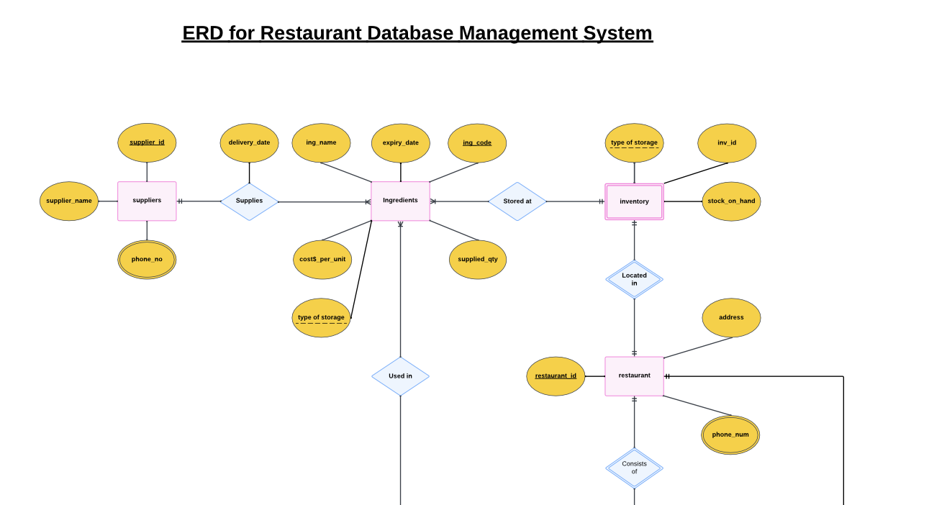
ERD PLANNING
(ERD PART 1)

Slide 6
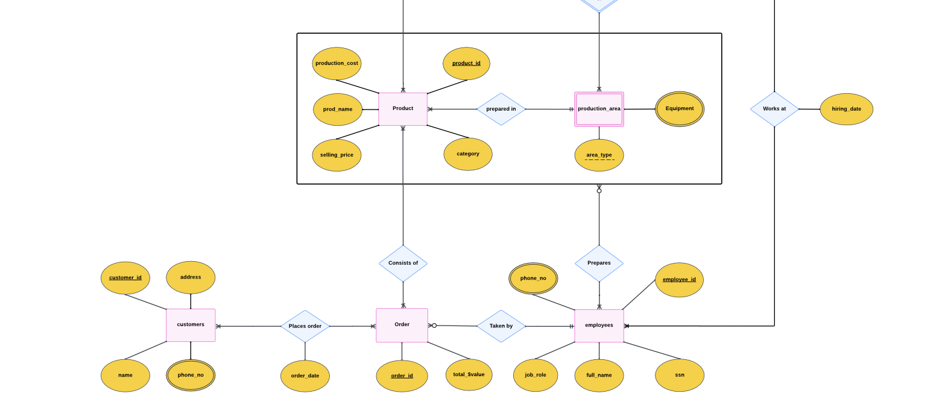
ERD PART 2

Slide 7
RELATIONAL SCHEMA MAPPING
suppliers(supplier_id,supplier_name,phone_no)
B) ingredients(ing_code, ing_name,cost$_per_unit, supplied_qty,expiry_date, supplier_id[FK],type_of_storage,actual_delivery_date) )
C) inventory(inv_id,restaurant_id[FK],ing_code[FK],stock_on_hand,type_of_storage)
D) restaurants(restaurant_ id,address, phone_no)
E) production_area(area_type, equipment,restaurant_id[FK],employee_id[FK] )
F) products(product_id,category, production_$cost, selling_$price,prod_name)
G) employees(employee_id,job_role,restaurant_id[FK],full_name, ssn, hiring_date, phone_no)
H) orders(order_id,total_$value,order_date,employee_id[FK],restaurant_id[FK],product_id[FK],customer_id[FK])
I) customers(customer_id, customer_name, address, phone_no)

Slide 8

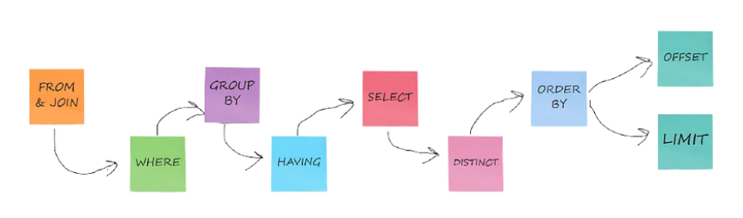
QUERY EXECUTION

Slide 9
Query #1
Business Question
SQL Query
SELECT RESTAURANT_ID,JOB_ROLE,COUNT(DISTINCT EMPLOYEE_ID) AS EMPLOYEE_COUNT
FROM employees WHERE RESTAURANT_ID = 5
GROUP BY RESTAURANT_ID,JOB_ROLE ;
FIND THE NO. OF EMPLOYEES IN EACH JOB ROLE FOR A GIVEN RESTAURANT?
Business Implication:
To identify overstaffing / understaffing.

Slide 10
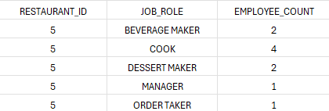
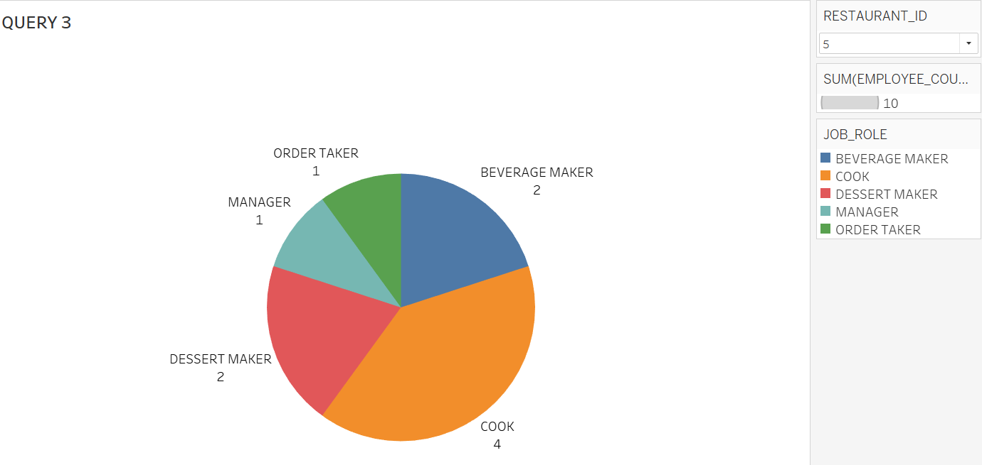
Explanation
Output
To produce the required output in SQL, the following keywords and functions were used:
SELECT: To display in the columns such as RESTAURANT_ID, JOB_ROLE
FROM: To indicate the table (“employees”) containing the data
WHERE: To filter the query to focus on a specific restaurant (RESTAURANT_ID = 5).
GROUP BY: To group/aggregate the data by JOB_ROLE
COUNT(): To count the number of employees in each job role.

Slide 11
Query #2
Business Question
SQL Query
WHAT IS THE AVERAGE LENGTH OF SERVICE OF EMPLOYEES ACROSS EACH JOB ROLE?
Business Implication:
To identify experience-gap or employee-retention status.
SELECT
JOB_ROLE,
ROUND(AVG(DATEDIFF('2025-01-01', HIRING_DATE) / 365.0),2) AS AVG_LENGTH_OF_SERVICE_YEARS
FROM
EMPLOYEES
GROUP BY
JOB_ROLE;

Slide 12
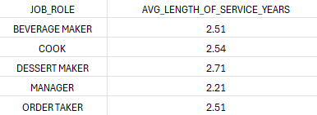
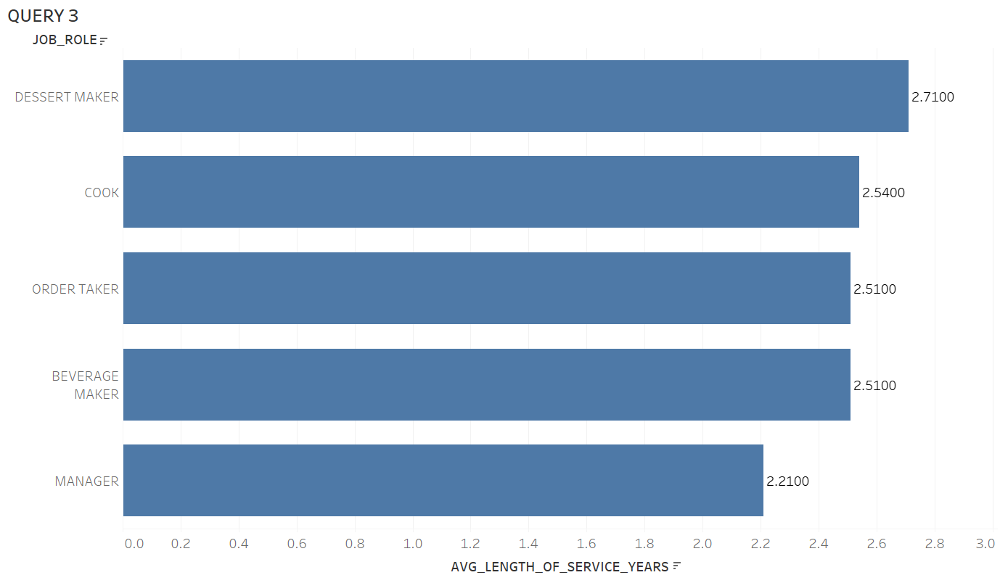
Explanation
Output
To produce the required output in SQL, the following keywords and functions were used:
SELECT: To specify the columns, such as JOB_ROLE and the calculated average length of service.
AVG(): To compute the average length of service: (AVG(LENGTH_OF_SERVICE_YEARS)).
FROM: To indicate the table containing the employee data.
GROUP BY: To group JOB_ROLE wise average length of service

Slide 13
Query #3
Business Question
SQL Query
SELECT t1.*,t2.customer_name as CUSTOMER_NAME from
(WITH RankedCustomers AS (
SELECT
RESTAURANT_ID,
CUSTOMER_ID,
SUM(TOTAL_$VALUE) AS TOTAL_VALUE,
ROW_NUMBER() OVER (PARTITION BY RESTAURANT_ID ORDER BY SUM(TOTAL_$VALUE) DESC) AS rank
FROM
ORDERS
GROUP BY RESTAURANT_ID,CUSTOMER_ID
) SELECT RESTAURANT_ID,CUSTOMER_ID,TOTAL_VALUE
FROM
RankedCustomers
WHERE
rank <= 3
ORDER BY
RESTAURANT_ID,
rank) as t1 left join customers t2 on t1.CUSTOMER_ID= t2.CUSTOMER_ID
WHERE RESTAURANT_ID = 5;
IDENTIFY THE TOP 3 POTENTIAL CUSTOMERS FOR A GIVEN RESTAURANT BASED ON TOTAL $VALUE?
Business Implication:
To identify customers for loyalty-reward.

Slide 14

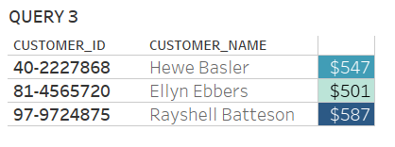

Explanation
Output
By executing the query we can infer the following:
It helps in retrieving the top 3 highest-spending customers for a specific restaurant (RESTAURANT_ID = 5) along with their customer names and total spending amounts (TOTAL_VALUE).
It ranks customers based on their total spending within the restaurant, ensuring that only the top contributors are identified.
The output provides actionable insights by linking the customer ID with customer names for better understanding and personalization.
Identifying top-spending customers helps enhance loyalty and retention through targeted rewards and personalized experiences. It also enables restaurants to maximize revenue by focusing on their most valuable patrons.

Slide 15
Query #4
Business Question
SQL
SELECT
T.product_id,
T.prod_name,
T.total_profit
FROM (
SELECT
p.product_id,
p.prod_name,
SUM((p.selling_$price - p.production_$cost) * o.total_$value) AS total_profit,
RANK() OVER (ORDER BY SUM((p.selling_$price - p.production_$cost) * o.total_$value) DESC) AS rank
FROM
orders o
JOIN
products p ON o.product_id = p.product_id
GROUP BY
p.product_id, p.prod_name
) T
WHERE
T.rank <= 5
ORDER BY
T.total_profit DESC;
IDENTIFY THE TOP 5 MOST PROFITABLE ITEMS FOR THE BUSINESS?
Business Implication:
To identify most-profitable items.

Slide 16
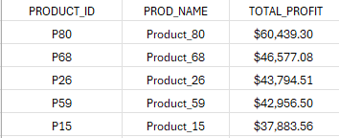
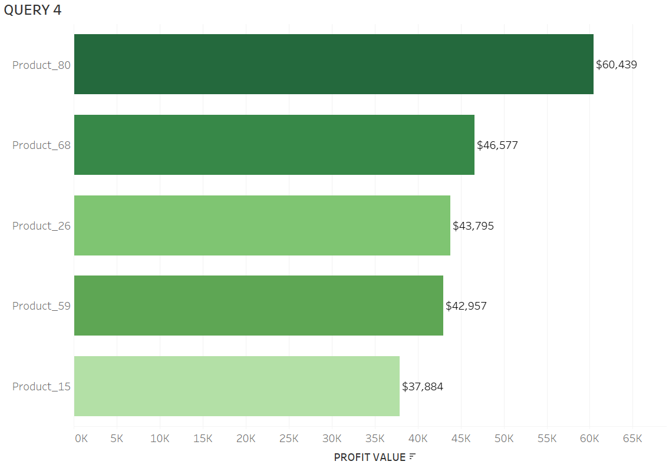
Explanation
Output
By executing the query we can infer the following:
It calculates the total profit generated by each product by considering the difference between the selling price and production cost, multiplied by the total sales value.
It ranks all products based on profitability using the RANK() function and retrieves the top 5 most profitable products along with their names and profit values.
The output is sorted in descending order of total profit to highlight the products contributing most to the business’s revenue.
Identifying the most profitable products enables the restaurant to focus on promoting these items, optimizing inventory for high-demand, high-margin items, and improving overall profitability by aligning marketing and sales efforts with these insights.

Slide 17
Query #5
SQL
Business Question
SELECT INV.*,ING.ING_NAME FROM
(SELECT
RESTAURANT_ID,
ING_CODE,
SUM(STOCK_ON_HAND) AS TOTAL_STOCK,
CASE
WHEN SUM(STOCK_ON_HAND) <= 25 THEN 'Needs Attention'
ELSE 'Sufficient stock'
END AS ORDER_STATUS
FROM
inventory
GROUP BY RESTAURANT_ID,ING_CODE) as INV LEFT JOIN
(SELECT DISTINCT ING_CODE,ING_NAME FROM INGREDIENTS) as ING
ON ING.ING_CODE = INV.ING_CODE WHERE RESTAURANT_ID = 50;
WHICH INGREDIENTS REQUIRES URGENT RESTOCKING FOR EACH RESTAURANT?
Business Implication:
To identify inventory of items for restocking.

Slide 18
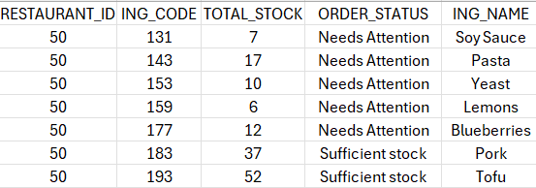
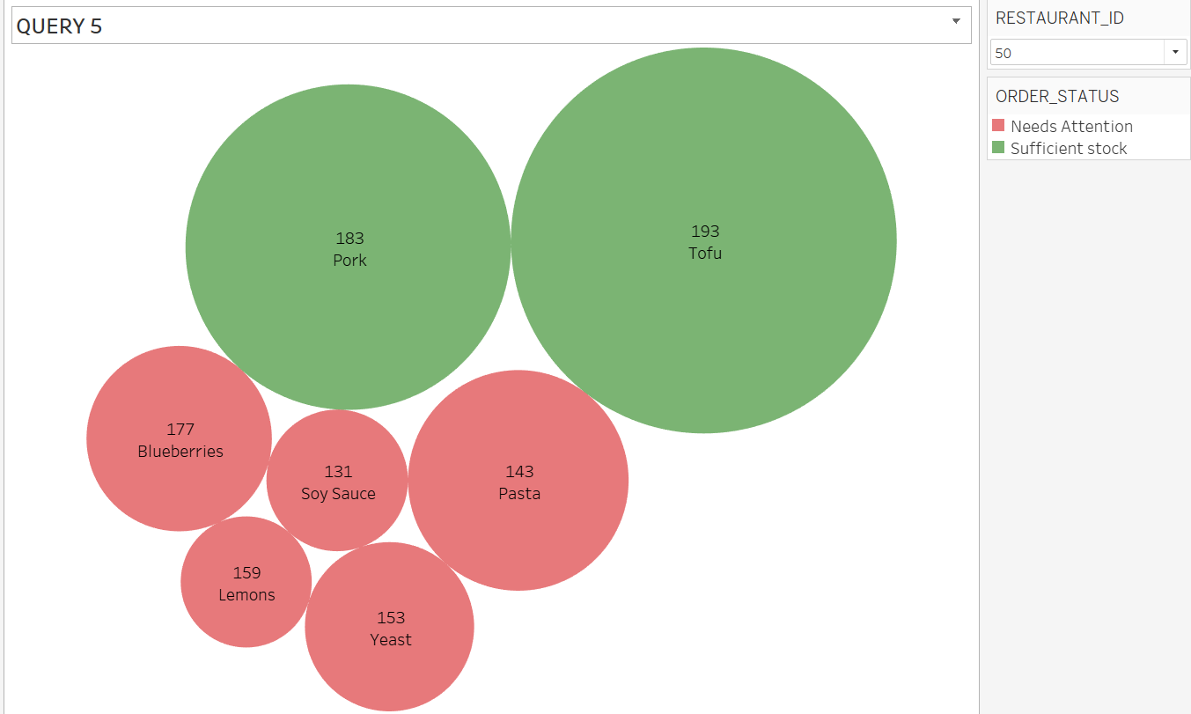
Explanation
Output
This query generates a stock report for a specific restaurant.
It shows total stock of each ingredient.
Adds a status according to the level of inventory.
Matches the ingredient name to each ingredient code for clarity.
The output helps Managers to quickly identify which ingredients are to be replenished.

Slide 19

CONCLUSION
The project successfully implemented a comprehensive Restaurant Database Management System aimed at improving operational efficiency in restaurant management. By centralizing data related to orders, menu details, employee records, inventory, and customer information, the system ensures streamlined data management, reduces redundancies, and enhances decision-making processes.
Key achievements include:
Development of an Entity-Relationship Diagram (ERD) to structure the database.
Implementation of a relational schema that supports realistic restaurant operations.
Query execution for critical business insights, such as identifying staffing needs, assessing employee retention, recognizing top customers, evaluating the profitability of menu items, and determining urgent inventory restocking needs.
The system demonstrates the potential to address real-world restaurant challenges effectively, offering actionable insights for managers to optimize resources and improve business performance.

